Slide 1
Class of 2019
Junior College Night
February 2018
Mrs. Beth Walter/Mrs. Whitney Niles (Students A-F)
Mr. Mike Moffitt (Students G-O)
Mrs. Tara Maka (Students P-Z)
Mr. Albert Spiegel ‘95 (Director of Scheduling)
goo.gl/wegEQQ
Notes:
‹#›

Slide 2
Tonight’s Presentation
goo.gl/wegEQQ

Slide 3
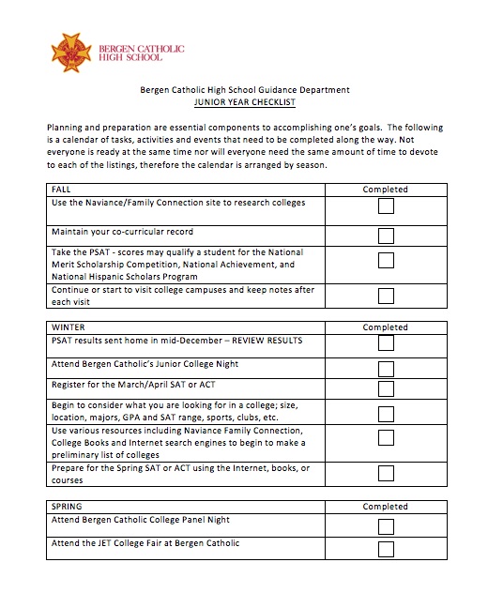
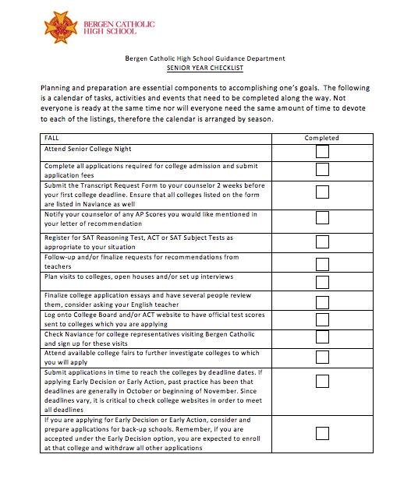
Junior Year and Senior Year Checklists

Slide 4
The College Search
Step 1: College Search

Slide 5
College Search
Before you start looking for a college, identify your preferences.
Consider things like…
Major or academic interest
School type: Two-year vs. four-year, Public vs. Private, Rural, Urban, Suburban, Religious Affiliation
Location
Student body: Size, In-State vs. Out-of-State
Admission: Competitiveness
Extras: Sports, activities, special programs
Cost
Use Naviance!

Slide 6
What is Naviance?
Web-based resource that supports career and college planning
Online tool for collaboration among counselors, students, and parents
Family Connection is directly linked to Counselor’s Office
Always check your BC email for messages from your counselor!

Slide 7
What can you do with it?
Research colleges
Scattergrams: Compare GPA, standardized test scores, and other statistics to actual historical data from our graduates.
College Search: Review and compare college profiles
College Match - recommend schools based on your GPA and test scores.
View schedule of college visits - for Seniors only
Scholarship List: Provides local and national scholarships for Seniors to apply to
Colleges I’m Thinking About: Keeps a stored list of favorite schools

Slide 8
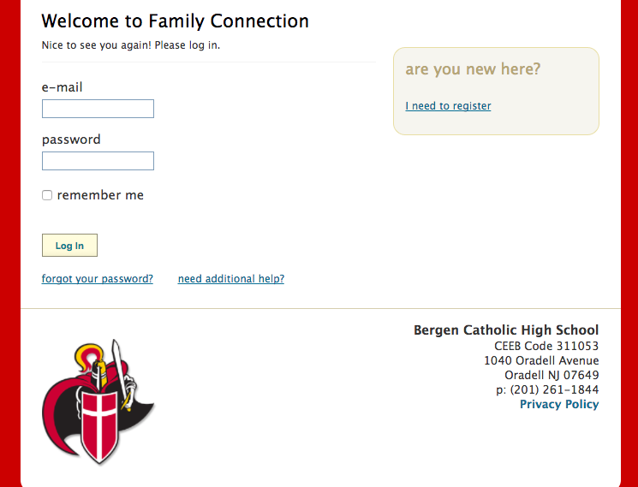
How Is It Accessed?
Online via http://connection.naviance.com/bergenchs

Slide 9
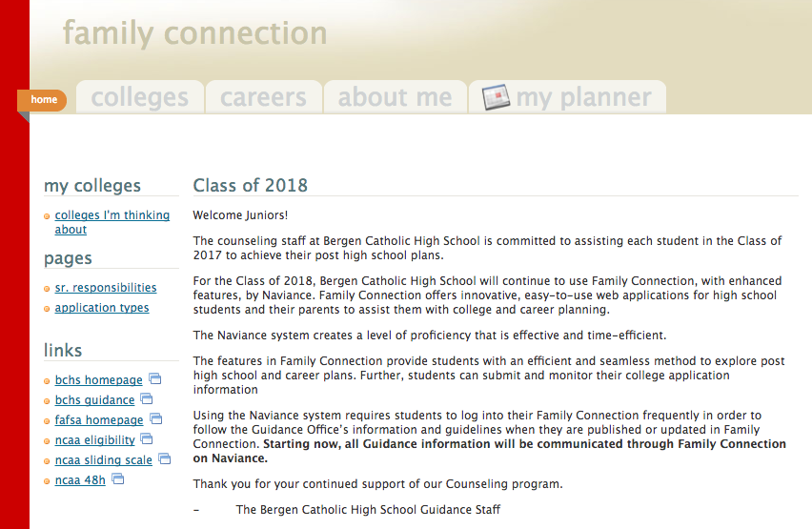
College Search on Naviance
College Search

Slide 10
College Search on Naviance
Search for schools using the various filters:
Type of School
Location
Campus Size
Activities and Sports
Majors and Academics
Admissions
Cost
Special Programs

Slide 11
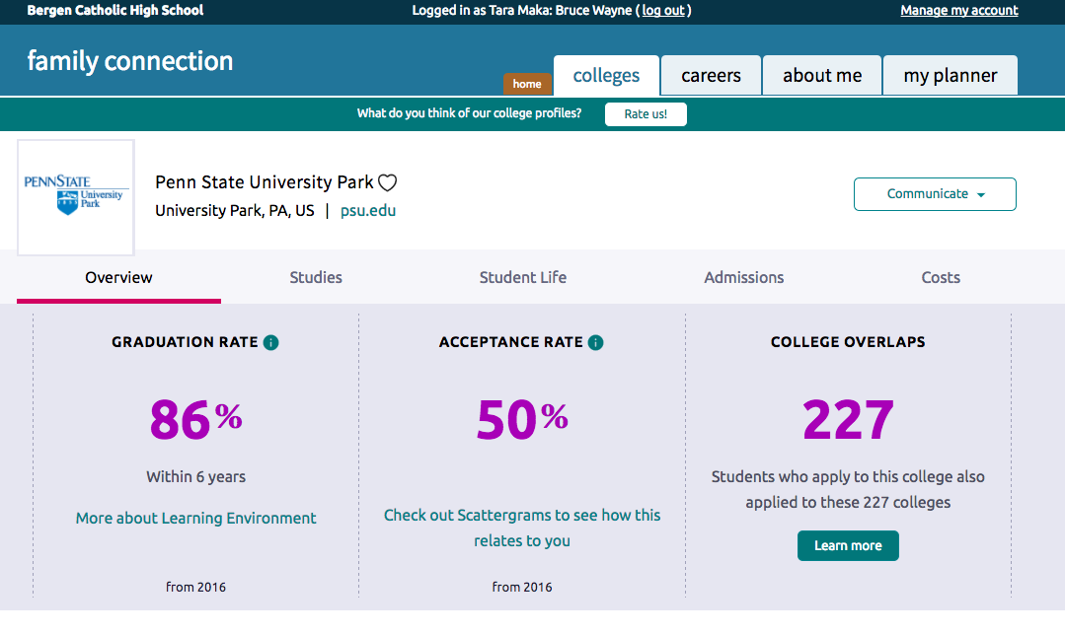
College Profile

Slide 12
Class of 2018 College Timeline
SPRING:
Attend College Open Houses/Visit Schools
Develop College List
Register & take ACT/SAT
Take Subject tests if needed
JANUARY:
File FAFSA online by Feb. 15
Apply for local scholarships
SUMMER INTO SENIOR YEAR:
Common App. available to begin
Work on completing essays/supplements
Finalize teacher recommendations verbally and provide them with information they require
Finalize your working resume
FEBRUARY-MAY:
Early February - Mid-Year Reports Sent to Colleges
Waitlisted? Deferred? See your counselor
SEPTEMBER-DECEMBER:
Complete CSS PROFILE/ FAFSA online (Oct.1)
Meet College Reps., Interview, Attend over-nights, Official Visits, etc.
Finalize list of Colleges- Choose EA, ED, Rolling Admission Plan
Take Final ACT/SAT test

Slide 13
Step 2: Visit Colleges

Slide 14
Campus Visits
Best to visit when school is in session
Winter/Easter breaks
Senior privilege: 2 excused absences for college visits - make sure to get a letter from the college
Sign up for an interview
Take notes, ask questions, evaluate what you see and hear, and take pictures!
Try not to judge the school based on the tour guide, weather, etc.

Slide 15
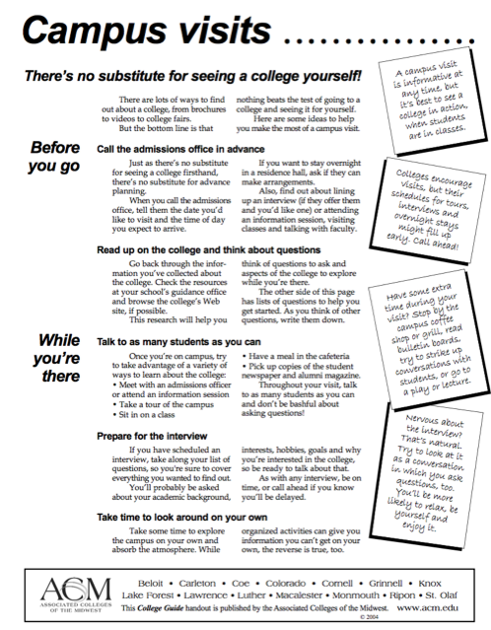

Slide 16
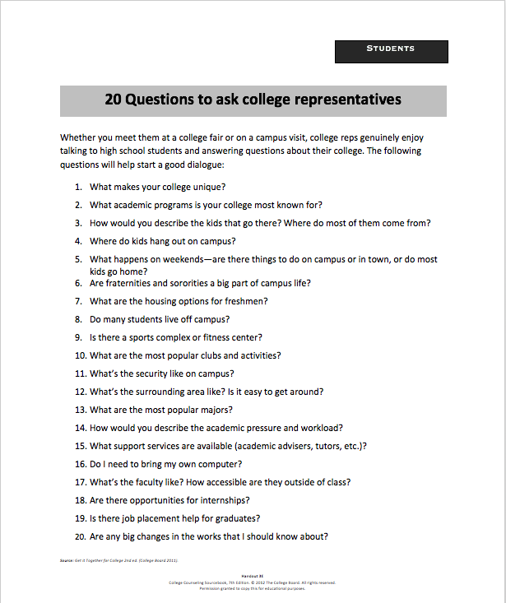
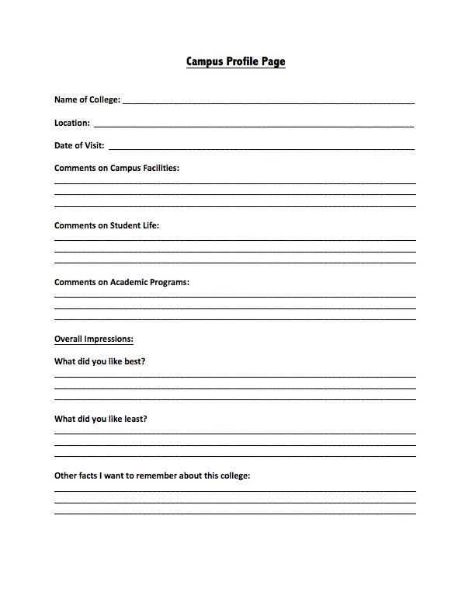

Slide 17
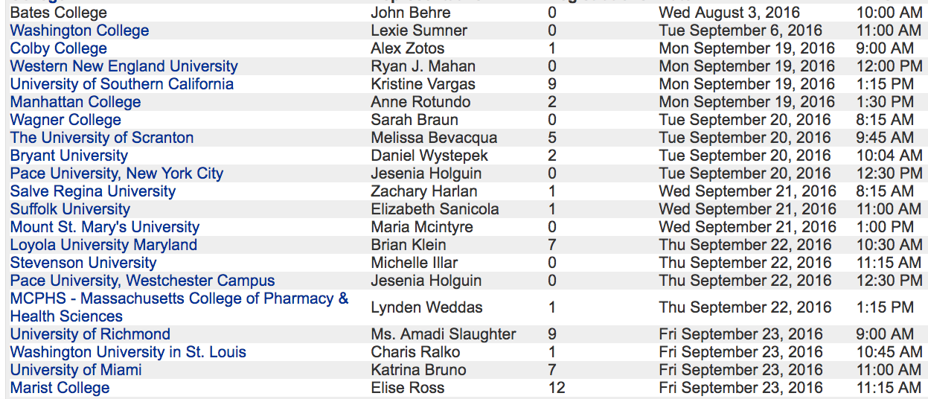
College Visits to Bergen Catholic

Slide 18
College Fairs
Bergen Catholic Jesuit College Tour
April 29, 2017
8:47 - 2nd period
Hoehl Gymnasium - Juniors only
Immaculate Heart Academy
Annual Spring College Fair
April 10, 2018
7-9pm
IHA Gymnasium
New Jersey National College Fair
Meadowlands Exposition Center at Harmon Meadows
355 Plaza Drive, Secaucus, NJ
Fair Hours:
Wednesday, April 25, 2018
9 am to 12 pm
5 pm to 8 pm

Slide 19
Getting the most out of the College Fair
Bring a pen and notebook for notes and a bag to collect literature
Print out self-addressed labels with all relevant personal information including your high school name - this way you will spend more time talking to representatives and less time filling out contact cards!
Be prepared with questions to ask the representatives about their school
Remember to pick up business cards of any representatives that you speak with

Slide 20
Step 3: Refine and Balance the List!

Slide 21
Refine and Balance the List!
Importance of a well balanced list
Identify likelihood of admission
Safety, target, reach list
6-8 applications
Use the quantifiables
GPA
SAT/ACT scores
2 safeties = less stress
More likely to receive scholarship

Slide 22
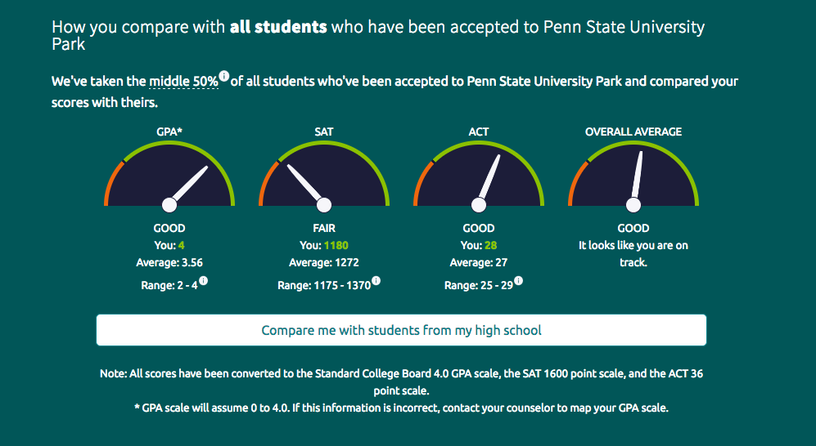
Compare personal statistics to
National Data on Naviance

Slide 23
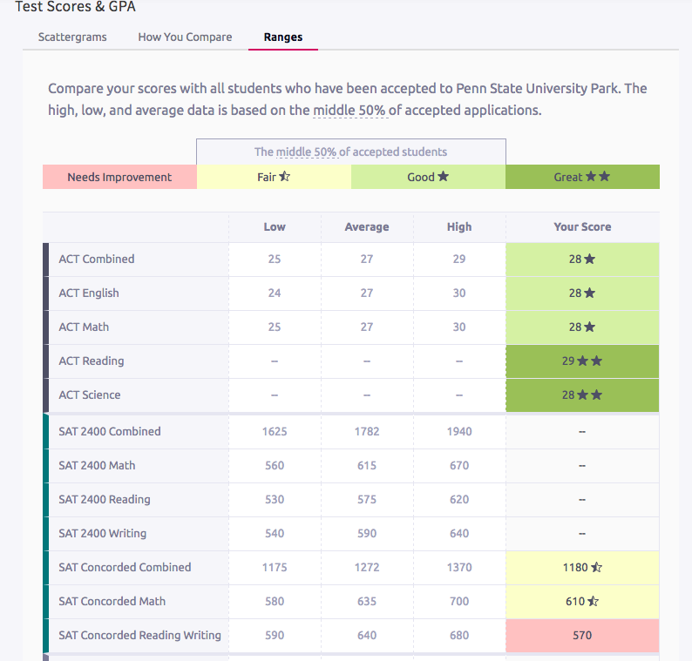
How you compare

Slide 24
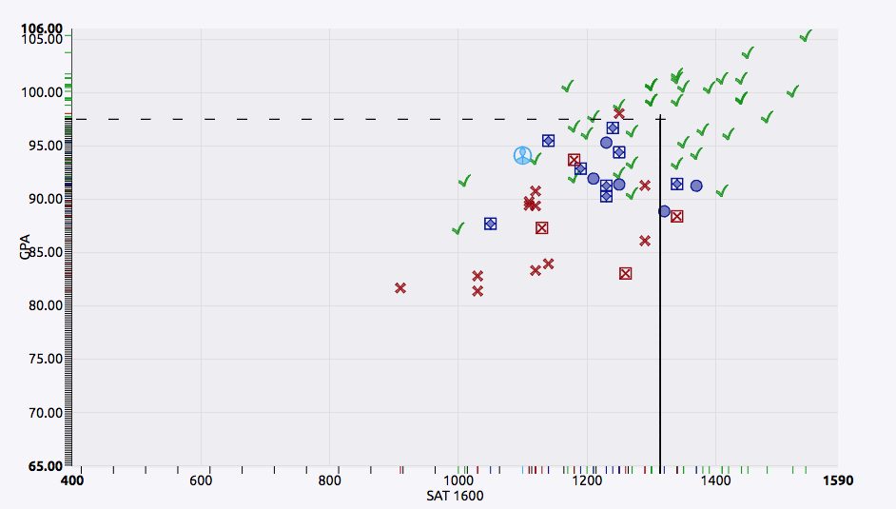
Scattergrams
Reach

Slide 25
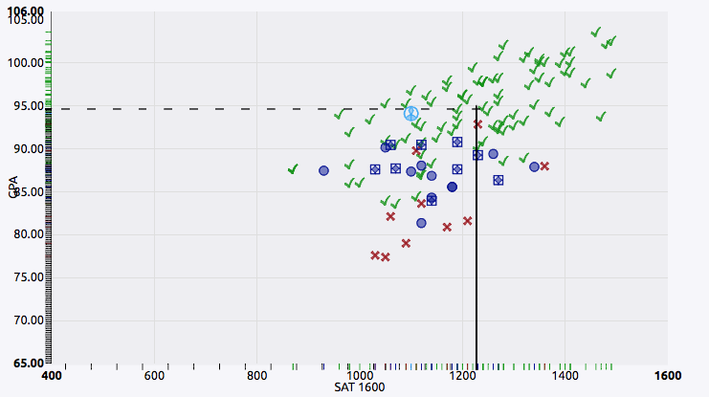
Scattergrams
Target School

Slide 26
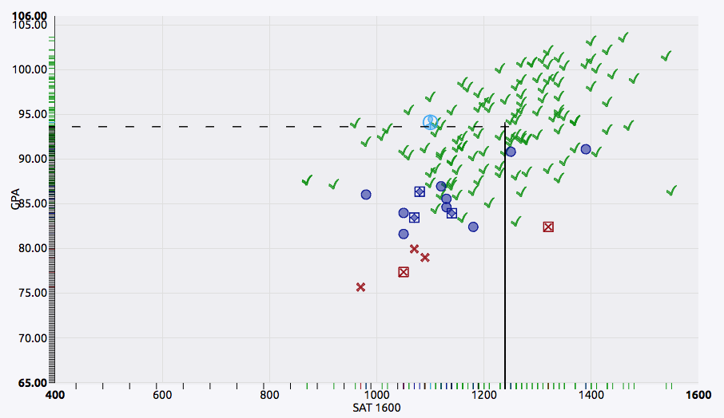
Scattergrams
Safety School

Slide 27
Step 4: Plan for Testing

Slide 28
College Entrance Exams
Know which tests are required for admission
SAT: Components include critical reading, math, and writing (optional)
ACT: Components include reading, math, science reasoning and English (essay optional)
SAT Subject tests: Measure knowledge and skills in particular areas (History, Literature, Language, Science, Math, Foreign Language)
Register for the SAT/ACT
When?
SAT/ACT - Spring
SAT subject tests - May/June
SAT/ACT/SUBJECT TESTS: Student’s responsibility to send scores to the colleges from ACT or College Board!

Slide 29
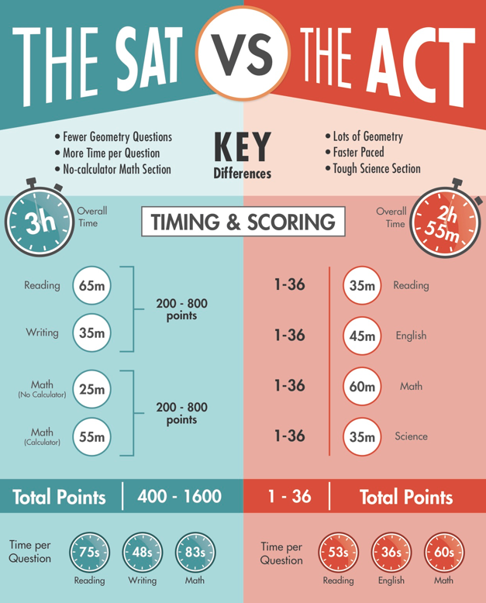
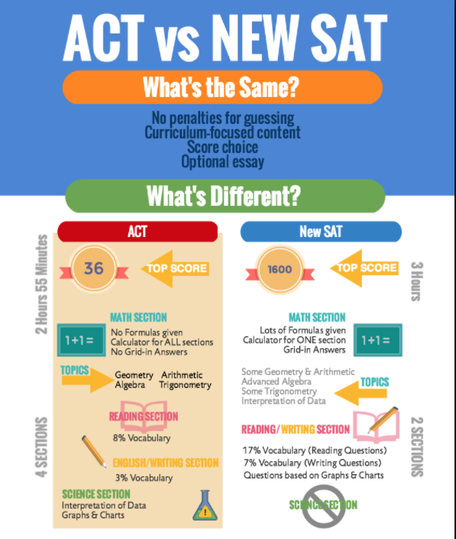

Slide 30
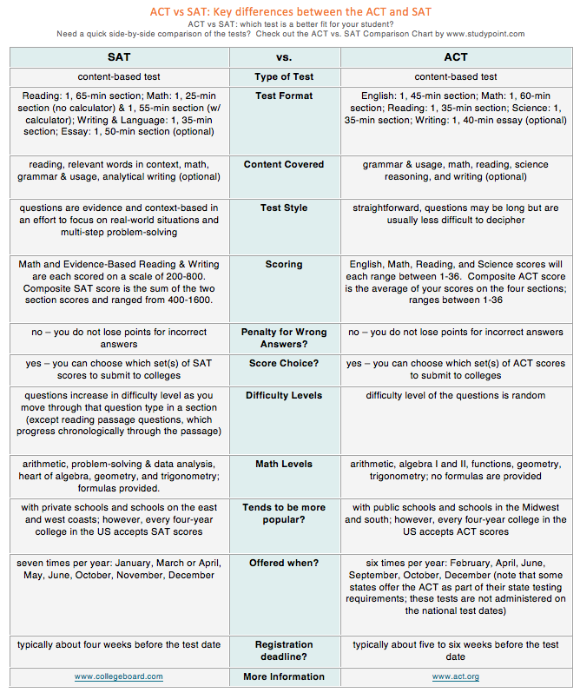

Slide 31
SAT Test Dates
Register for the SAT online through www.collegeboard.com
Test Date | Registration Deadline
March 10, 2018 | February 9, 2018
May 5, 2018 | April 6, 2018
June 2, 2018 | May 3, 2018
August 25, 2018 | **Anticipated test date
October 6, 2018 | **Anticipated test date
November 3, 2018 | **Anticipated test date
December 1, 2018 | **Anticipated test date

Slide 32
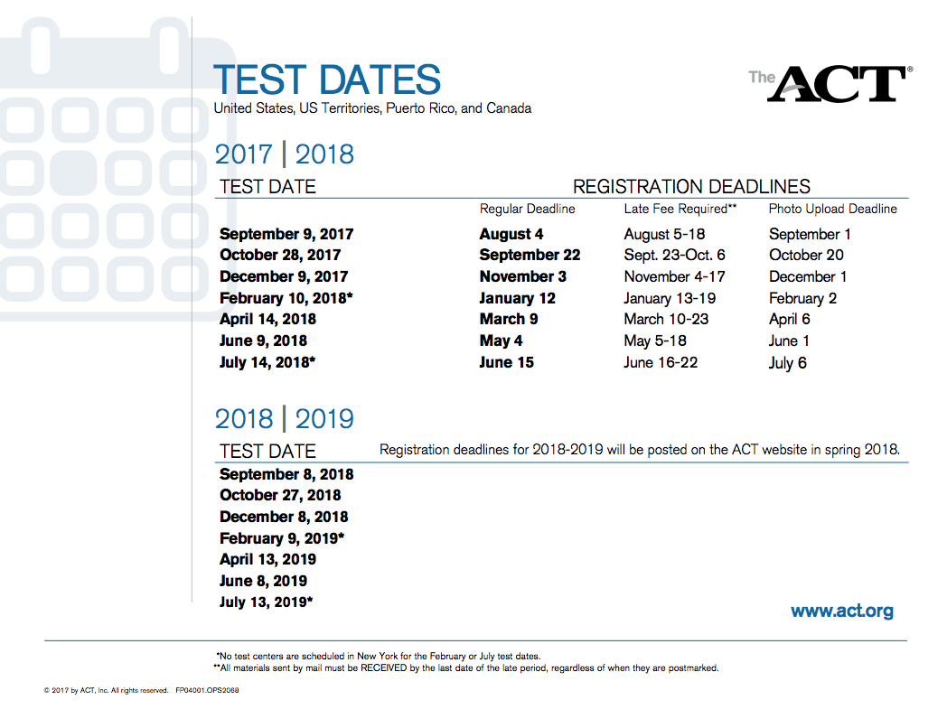
ACT Test Dates
Register online at www.act.org

Slide 33
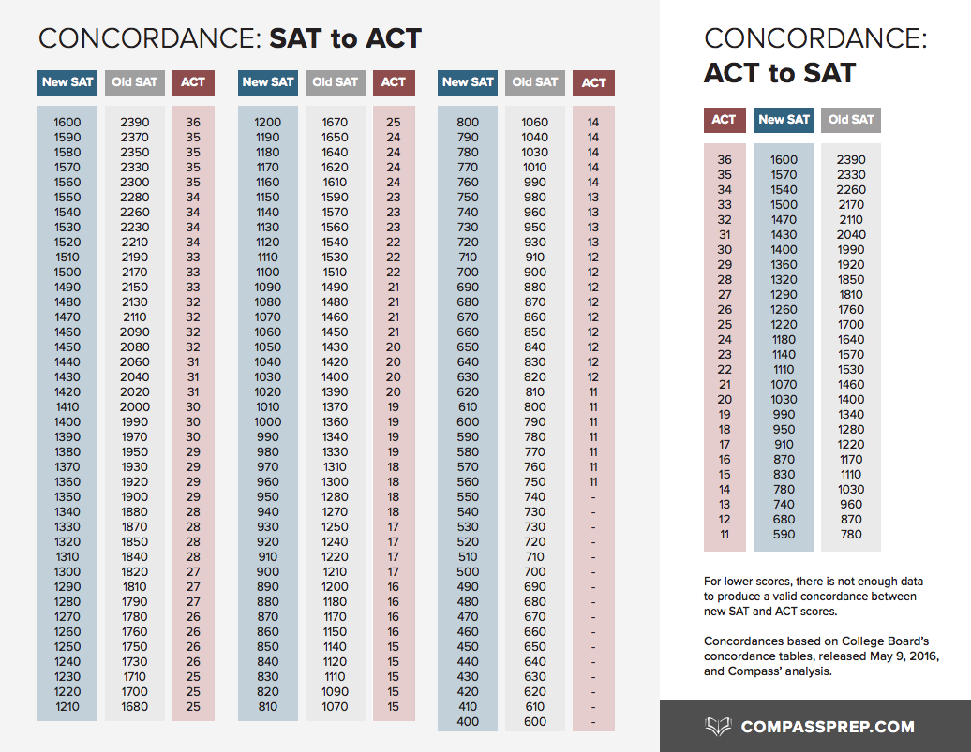
SAT/ACT Concordance Chart
Source: http://www.compassprep.com/comparing-act-and-new-sat-scores/

Slide 34
Not all schools Require SAT/ACT Scores
More than 900 four-year colleges and universities do not use the SAT or ACT to admit substantial numbers of bachelor-degree applicants.
Source: www.fairtest.org

Slide 35
A small sample of schools that do not require the SAT/ACT
Bates College
Bowdoin College
Bryant University
Connecticut College
College of the Holy Cross
DeSales University
Drew University
Drexel University
Fairfield University
Franklin and Marshall College
Georgian Court University
Gettysburg College
Hobart and William Smith Colleges
Johnson and Wales University
Loyola University
Marist College
Muhlenberg College
New York University
Providence College
Saint Joseph’s University
Stonehill College
Susquehanna University
University of Scranton
Wesleyan University
Source: www.fairtest.org

Slide 36
Step 5: Gather the Components of
the Application

Slide 37
Types of Applications
3 ways to apply - the school’s application, the Common Application, the Coalition Application
The Coalition Application - currently only 130 member colleges
Common Application - apply to over 600 colleges with ONE application.
The Common Application and essays are available now!
Most important piece of the process is the student's application and that the application arrives on time
DO NOT MISS THE DEADLINE!!!

Slide 38
Applying Early?
Early Decision (ED) - a binding agreement. Once accepted, student MUST attend the school.
Early Action (EA) - Apply early and receive an admission decision early (usually December or January.)
Regular - Applications are due from January to March, outcome is mailed in April
Early Action and Regular Decision deposits are due by May 1st.
Read through the school’s fine print to ensure you understand their deadlines.

Slide 40
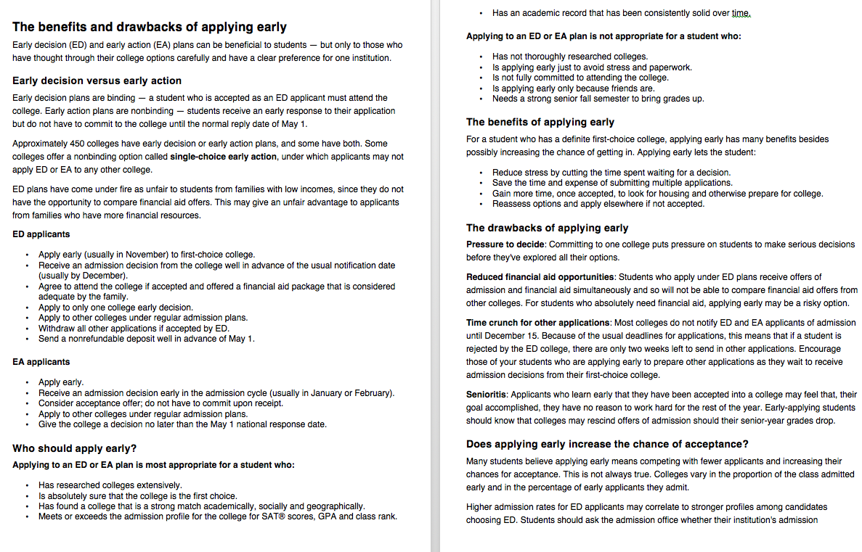

Slide 41
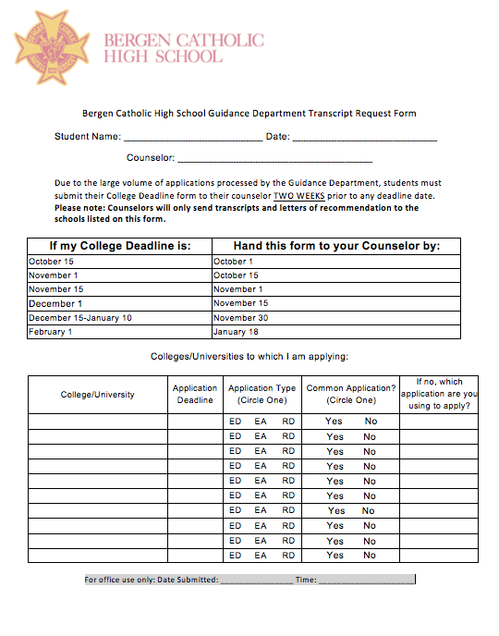
Transcript Request Form

Slide 42
Transcript
Colleges will look at all available grades
The high school transcript is submitted to colleges
Displays the final grades received in every subject from freshman through junior year
Senior grades are submitted at the end of the first semester (also known as Mid-year Reports)
Cumulative GPA is listed on the transcript.
Colleges now requesting First Quarter Senior year grades more so than previous years.

Slide 43
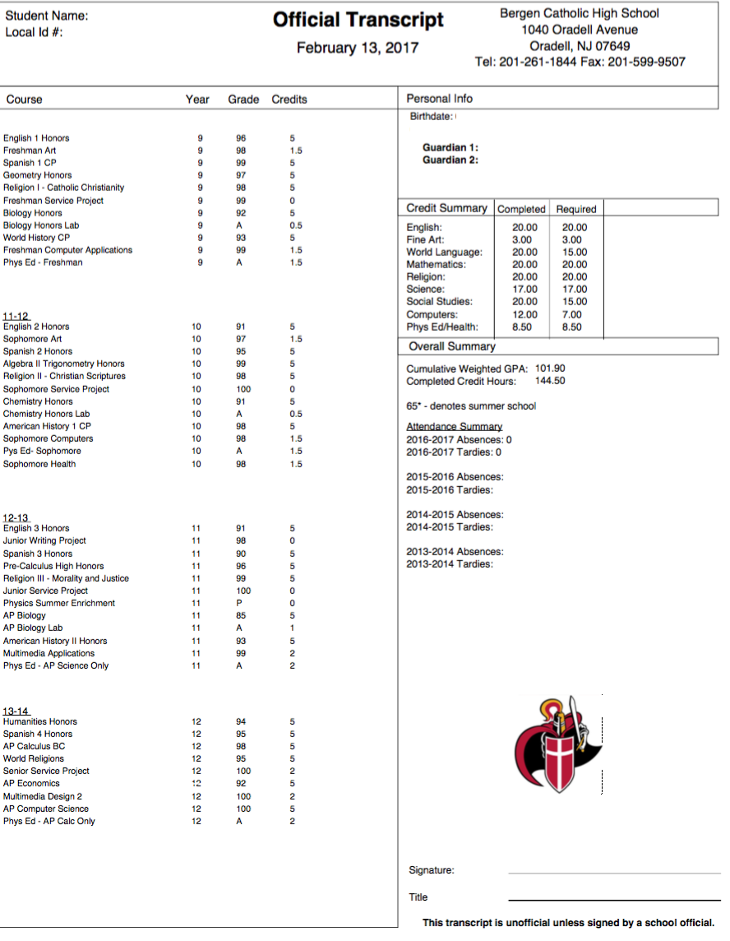
Sample Transcript

Slide 44
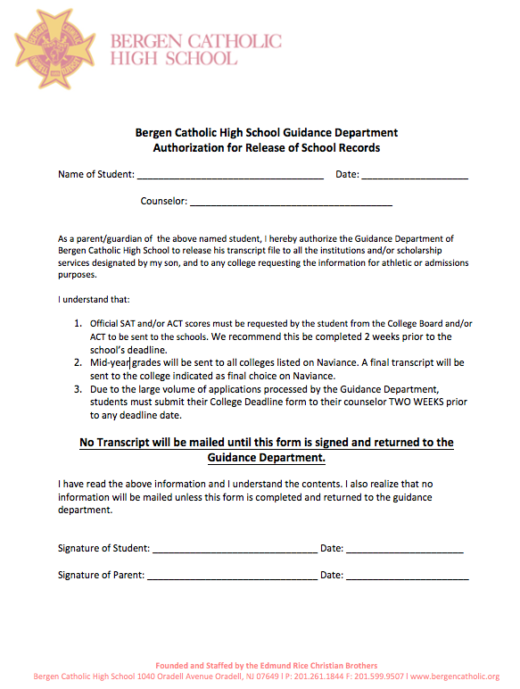
Transcript Release Form

Slide 45
Resume
Colleges are looking for individuals that will enhance their campus
Colleges are looking for resumes with QUALITY rather than QUANTITY in their activities!
Emphasize the most significant activities. Exhibit level of commitment and leadership.
IT’S NEVER TOO LATE TO GET INVOLVED IN THE SCHOOL
AND THE COMMUNITY!

Slide 46
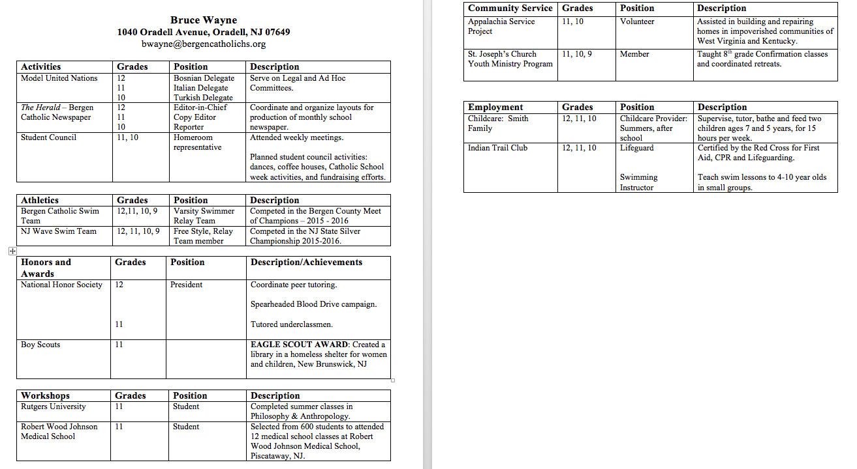
Sample Resume

Slide 47
College Essay
English teachers will address essays in class
Be yourself, be real! Creativity is highly valued!
Colleges want to see you in the framework of your passions, values, and writing mechanics
Proofread! Proofread! Proofread!
Ask your English teacher to review your essay.
2018-2019 Common Application Essay prompts are available now! Get a head start on your essay! (www.commonapp.org)

Slide 48
Letters of Recommendation
Two important letters: one from a guidance counselor and one from a teacher
Counselor letter: Counselors write a letter for each one of their students. It is sent along with the transcript.
Counselors require:
Parent Survey (Due March 21st)
Student Survey (Due March 21st)
Teacher letters: Students are responsible for requesting a letter from their teacher...IN PERSON! Some colleges require two letters. Do not send more than what is requested!
Teachers require:
Teacher Recommendation Survey (Due date determined by teacher. Must be at least 2 weeks prior to college application deadline)
All forms are available on Naviance and the Bergen Catholic website, under the Guidance page.

Slide 49
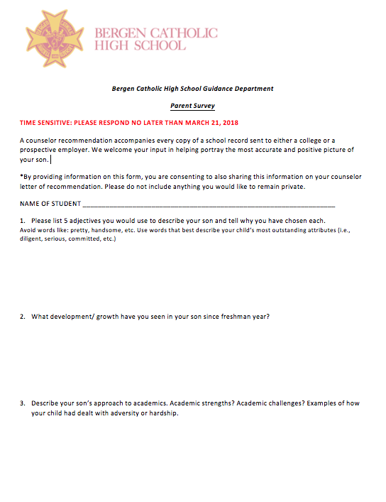
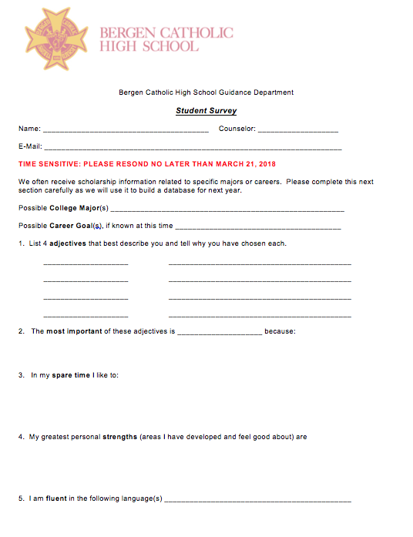
Parent Survey and Student Survey

Slide 50
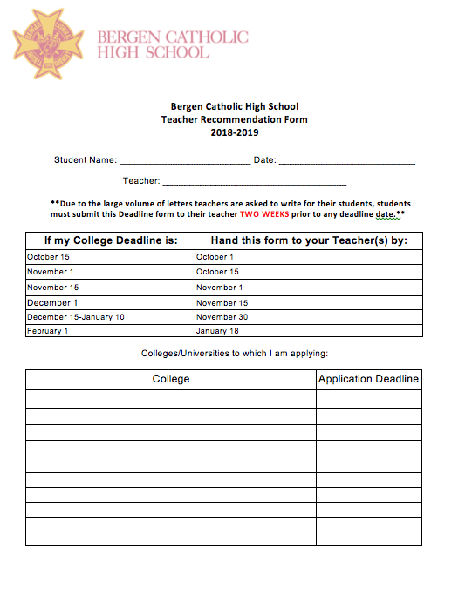
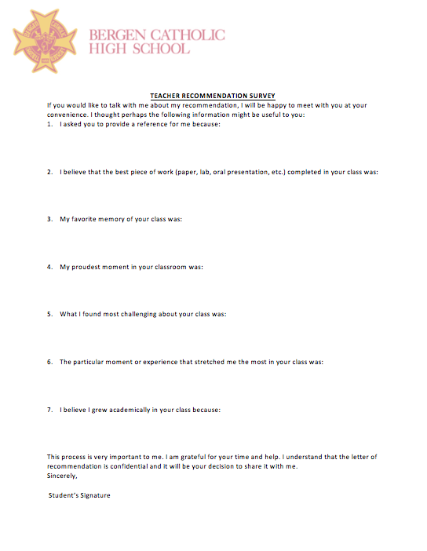
Teacher Recommendation Form

Slide 51
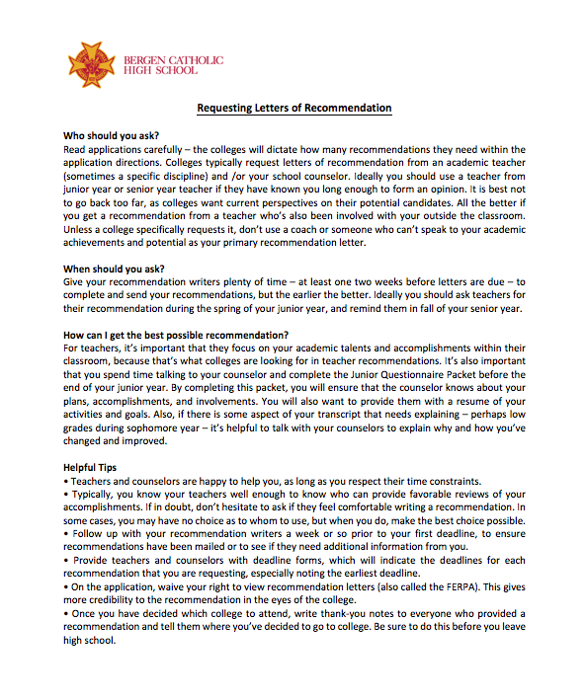
Requesting Letters of Recommendation Handout

Slide 52
How Parents Can Help
Complete the Parent Survey!
Topics to discuss with your student:
How much?
How far?
Encourage your student to keep his options open!
Research and visit colleges together. Use Naviance as a resource!
See the Glossary of Terms in the packet for the college terminology.

Slide 53
Step 6: Paying for College!

Slide 54
Types of Scholarships and Financial Aid
Federal student aid: Loans/grants
Merit Based from College or University
Privately awarded Scholarships
Community awarded Scholarships
Athletic scholarships- Division 1 and 2

Slide 55
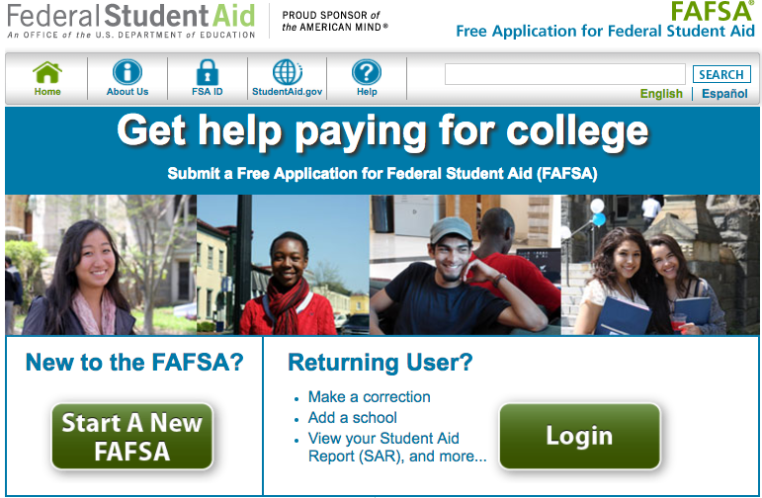
FAFSA
FAFSA- Federal Student Aid
Federal Subsidized, Unsubsidized
Student Loans
Parent Plus Loans
Grants
Scholarships

Slide 56
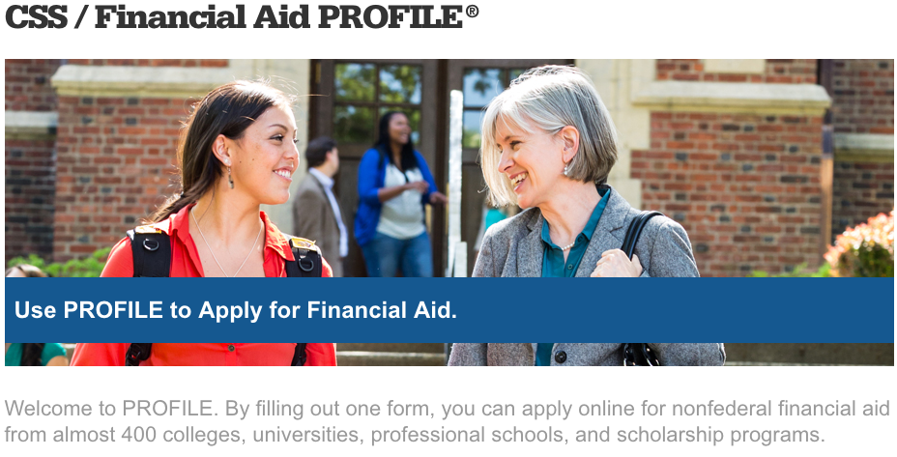
CSS Profile

Slide 57
CSS PROFILE VS. FAFSA
CSS Profile: Available Oct.1, 2017- Need to register on College Board. Some colleges participate with this service. Aids in obtaining Merit based award money.
http://css.collegeboard.org/
FAFSA- Available October 1, 2017- Need to obtain PIN and register for an account. Federal student aid- Loans, Scholarships and grants available here.
https://fafsa.ed.gov/index.htm

Slide 58
NCAA Requirements

Slide 59
Division 1 Academic Requirements
Athletes must complete 16 core courses and receive a minimum GPA of 2.3 in those courses. The core course requirements are as follows:
4 years of English, 3 years of Math (Algebra 1 or higher), 2 years of Natural or Physical Science, 2 years of Social Science, 1 extra year of English, Math or Science and 4 years of Religion, Philosophy, Foreign Language or additional years of any of the categories above.
10 of these classes are locked in before senior year begins.
Your core course GPA combined with your SAT/ACT score must meet the minimum requirements as laid out by the NCAA Sliding Scale.

Slide 60
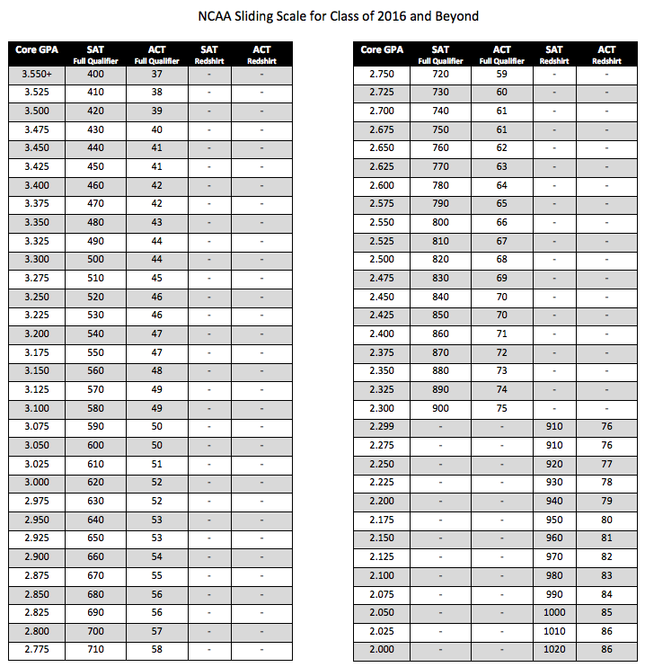
Division 1 Academic Requirements

Slide 61
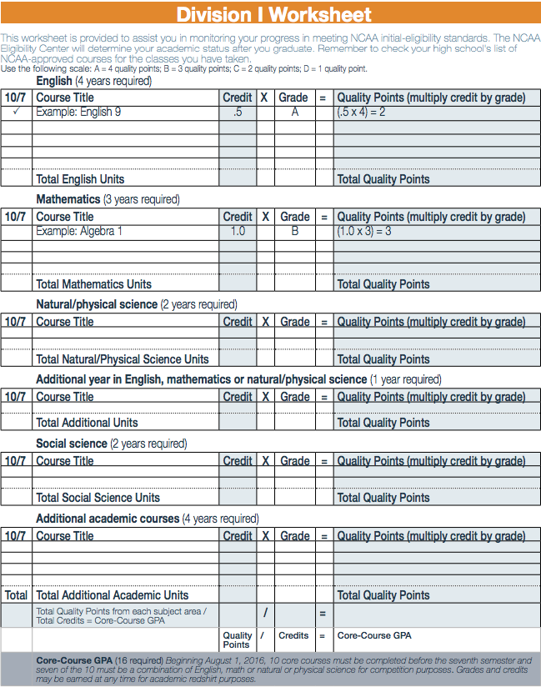
NCAA Division I Worksheet

Slide 62
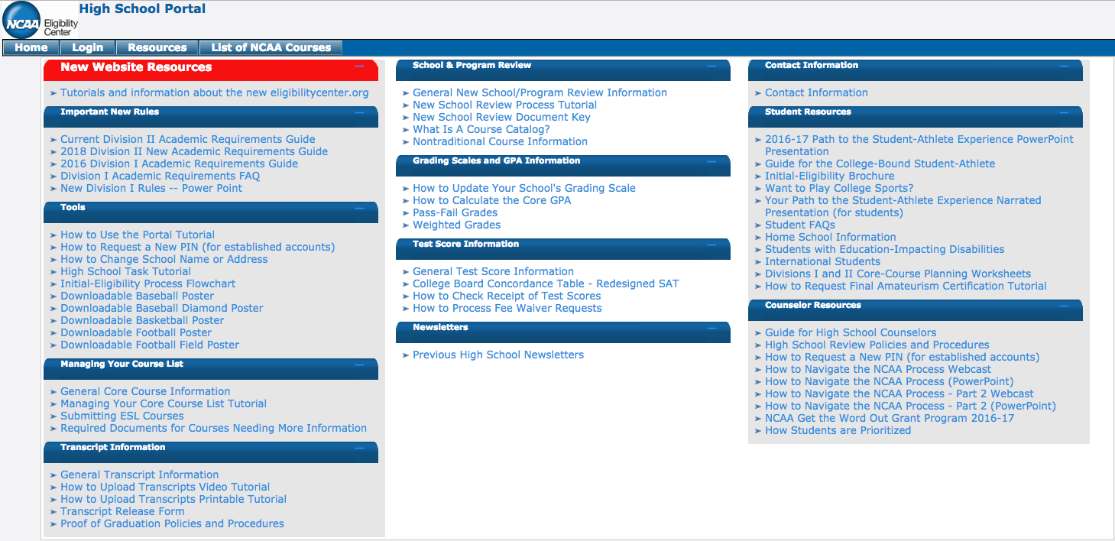
Resources

Slide 63
Useful Websites
College Searches Testing Services
www.collegeboard.com www.collegeboard.com
www.princetonreview.com www.act.org
www.petersons.com www.ets.org
Scholarships Other Sites
www.fastweb.com Common Application: www.commonapp.org
www.collegeexpress.com Campus tours: www.cmapustours.com
www.collegebpard.com/paying Campus viewbooks: www.campusview.com
www.srnexpress.com Test optional schools: www.fairtest.org
NCAA: www.ncaaclearinghouse.net
www.eligibilitycenter.org
Financial Aid
www.fafsa.ed.gov
www.finaid.org
www.hesaa.org
profileonline.collegeboard.com

Slide 64
Br. Jason M. Ford, CFC '01, MA
Iona College
Assistant Director of Admissions - Transfer Coordinator

Slide 65
Scheduling for Senior Year

Slide 66
Calculating Your GPA
Final Grade x Number of Credits x Course Multiplier = Weighted Grade
Sum of all Weighted Grades
= Weighted GPA
Sum of Earned Credits
Course Multipliers:
CP: 1.0
Honors: 1.1
AP: 1.15
Credits awarded only when course is completed.

Slide 67
Calculating Your GPA
Classes that do not count for GPA:
Physical Education
Science Lab
Learning Center
Jazz Ensemble / Vocal Ensemble / Chamber Ensemble
All full-year core classes: 5 credits
All semester-long electives: 2.5 credits
General Period Credits
Freshman/Sophomore Computers/Art/Health: 1.5 credits
Junior/Senior Computers: 2 credits

Slide 68
Simple GPA Calculation
COURSE | FINAL GRADE | COURSE MULTIPLIER | NUMBER OF CREDITS | SIMPLE GPA CALCULATION
English 3 CP | 95 | 1.0 | 5 | 95 x 1.0 x 5 = 475.0
Spanish 3 Honors | 88 | 1.1 | 5 | 88 x 1.0 x 5 = 440.0
AP Calculus AB | 84 | 1.15 | 5 | 84 x 1.0 x 5 = 420.0
Religion 3 | 99 | 1.0 | 5 | 99 x 1.0 x 5 = 495.0
Physics Honors | 91 | 1.1 | 5 | 91 x 1.0 x 5 = 455.0
US History CP | 87 | 1.0 | 5 | 87 x 1.0 x 5 = 435.0
Computers 3 | 85 | 1.0 | 2 | 85 x 1.0 x 2 = 170.0
TOTALS |  |  | 32 | 2890.0
SIMPLE GPA = 2890.0 / 32 = 90.3

Slide 69
Weighted GPA Calculations
COURSE | FINAL GRADE | COURSE MULTIPLIER | NUMBER OF CREDITS | WEIGHTED GPA CALCULATION
English 3 CP | 95 | 1.0 | 5 | 95 x 1.0 x 5 = 475.0
Spanish 3 Honors | 88 | 1.1 | 5 | 88 x 1.1 x 5 = 484.0
AP Calculus AB | 84 | 1.15 | 5 | 84 x 1.15 x 5 = 483.0
Religion 3 | 99 | 1.0 | 5 | 99 x 1.0 x 5 = 495.0
Physics Honors | 91 | 1.1 | 5 | 91 x 1.1 x 5 = 500.5
US History CP | 87 | 1.0 | 5 | 87 x 1.0 x 5 = 435.0
Computers 3 | 85 | 1.0 | 2 | 85 x 1.0 x 2 = 170.0
TOTALS |  |  | 32 | 3042.5
WEIGHTED GPA = 3042.5 / 32 = 95.08

Slide 70
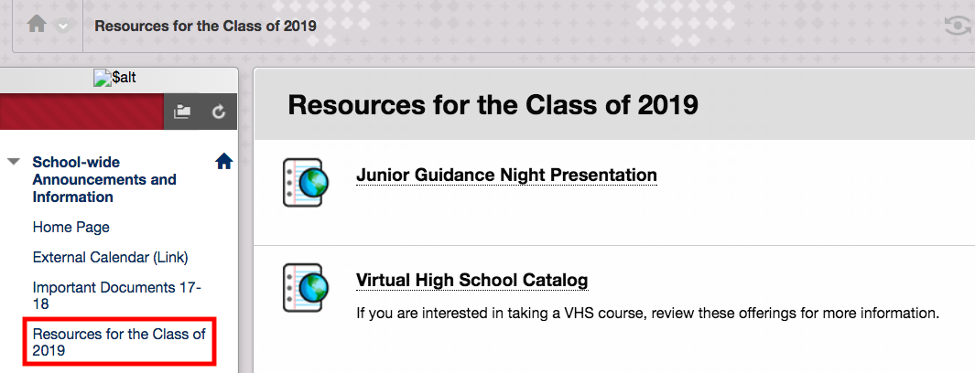
Scheduling Resources

Slide 71
Scheduling Caveats
Minimum grade for seniors is a 70
Must take AP exam for all AP courses you are enrolled in
Cannot drop a full-year course at the mid-year
Can drop semester course first 3 days of semester only
You must finish an underclassman course by taking the exam AFTER graduation
Juniors in AP must choose Senior AP Art as Elective #1
Do not choose courses based on teachers

Slide 72
Senior Year Schedule
English - required and placed by the department (Mr. O’Connor)
Math - required and placed by the department (Mr. Mascaro)
World Religions - required
General Period
Multimedia Design - required (regardless of other Computer courses)
2 meetings per cycle (hybrid)
Physical Education - required
1-4 meetings per cycle
Elective #1 (one full-year course or 2 half-year courses)
Elective #2 (one full-year course or 2 half-year courses)
Elective #3 (one full-year course or 2 half-year courses)

Slide 73
Elective Combinations
Your elective choices must equal 3 points
# Full-Year Courses | # Semester Courses
3 (3 points) | 0
2 (2 points) | 2 (1 point)
1 (1 point) | 4 (2 points)
0 | 6 (3 points)

Slide 74
Elective Combination Examples
Full-Year Courses | # Semester Courses
AP Computer Science AP Biology Mandarin 4 Honors (3 points) | None
AP Computer Science AP Biology (2 points) | Business Law Earth Science (1 point)
AP Computer Science (1 point) | Business Law Earth Science Economics Speech (2 points)
None | Business Law Astronomy Economics Speech Psychology VHS (3 points)

Slide 75
Department with Honors/AP Courses
Mr. O’Connor | Mr. Mascaro
Latin 4 Honors / AP AP Italian (Online) Spanish 4 Honors / AP Mandarin 4 Honors / AP AP American Government AP Economics | AP Statistics AP Biology AP Computer Science A
English World Language Social Studies | Art Math Science Computer Science
Please consult the appropriate chairperson for all questions related to honors/AP placements.

Slide 76
Semester Electives
Fall Semester | Spring Semester
Speech Communications Forensic Science Astronomy Anatomy and Physiology Business Law Criminal Justice Computer-Aided Design Robotics | Sports Journalism Forensic Science Earth Science Anatomy and Physiology Economics Introduction to Psychology Computer-Aided Design Robotics
These courses do NOT require approval.

Slide 77
Scheduling Timeline
February - March 2018
Review Academic Guidelines (see Blackboard for link)
Meet with guidance counselor to review options
Discuss course selections with parents
At end of third quarter (March 27)
Complete elective form (Google Form) - Week of April 9
Cluster Chairs will review/approve honors/AP placements
Meet with counselor if not approved for honors/AP
May need to secure approval for new choices
Schedules by end of final exams
Approved courses will appear on PowerSchool

Slide 78
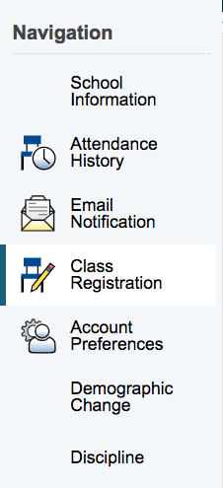
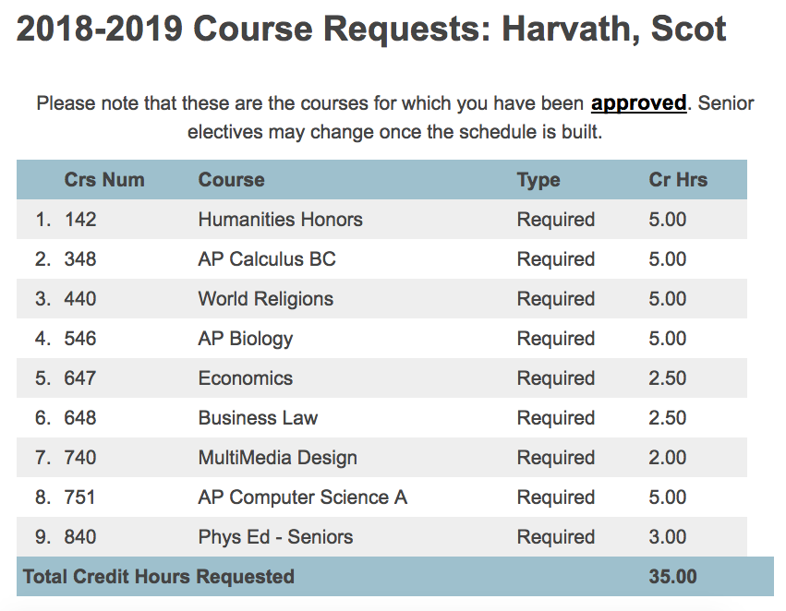
PowerSchool Course Requests

Slide 79
Virtual High School
15 seats per semester
Courses taught by highly qualified (certified) teachers from participating VHS schools
Can only enroll in one VHS course
List of courses: http://thevhscollaborative/catalog
May 10 - Registration for 18-19 VHS classes begins
Calendar different than BC
Fall: September 5 - December 18
Spring: January 2 - May 7 (Full-Year Courses)
January 23 - May 7 (Spring Semester Courses)

Slide 80
Virtual High School
All work is completed online
Scheduled for 1 period in library (6/7 cycle days; 291 minutes per cycle or 4.85 hours)
Time Commitment
Standard (CP): 6-8 hours per week
Honors: 8-10 hours per week
AP: 10-12 hours per week
Types of classwork
Discussions
Web tools to gather and share resources
Collaborate on group projects
Virtual labs

Slide 81
Previous VHS Courses
AP Physics 1
AP Physics C
AP Chemistry
AP Psychology
AP Music Theory
Biochemistry Honors
Oceanography
Differential Calculus
Personal Finance
Marketing and the Internet
Entrepreneurship
Investing in the Stock Market

Slide 82
Conflict Example
Need to schedule Business Law and Psychology
Business Law meets only in Period 3
Psychology meets only in Period 1
 | Day 1 | Day 2 | Day 3 | Day 4 | Day 5 | Day 6 | Day 7
Period 1 | Mandarin 4 Honors | Calculus Honors |  | Religion | General Period | English | AP Statistics
Period 2 | Calculus Honors |  | Religion | General Period | English | AP Statistics | Mandarin 4 Honors
HR | HR | HR | HR | HR | HR | HR | HR
Period 3 |  | Religion | General Period | English | AP Statistics | Mandarin 4 Honors | Calculus Honors
Period 4 | Religion | General Period | English | AP Statistics | Mandarin 4 Honors | Calculus Honors
Period 5 | General Period | English | AP Statistics | Mandarin 4 Honors | Calculus Honors |  | Religion
Period 6 | English | AP Statistics | Mandarin 4 Honors | Calculus Honors |  | Religion | General Period

Slide 83
Summary
Review materials on Blackboard - Class of 2019 Scheduling Info
Discussions - parents, guidance counselor, teachers, chairs
Complete Electives Form
Check PowerSchool for Course Requests

Slide 84
?
Do You Have Any Questions?
Mrs. Beth Walter/Mrs. Whitney Niles (Students A-F)
Mr. Mike Moffitt (Students G-O)
Mrs. Tara Maka (Students P-Z)
Mr. Albert Spiegel ‘95 (Director of Scheduling)
Placeholder, enter your own text here
?
goo.gl/wegEQQ

